Slide 1
Transforming Fear: The Impact of a Brief Values-Based Intervention on Avoidance Behavior in an Exposure Context
Timothy R. Ritzert, A. Theodore Artschwager, Christopher R. Berghoff, & John P. Forsyth
University at Albany, State University of New York
ACBS World Conference 14

Slide 2
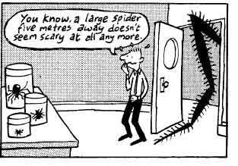
Anxiety Disorders & Exposure
Traditional targets of exposure therapy
Room for improvement
How can we increase willingness to face fear?
(Bouton, Mineka, & Barlow, 2001; Craske et al., 2008; Loerinc et al., 2015; Taylor, Abramowitz, & McKay, 2012)

Slide 3
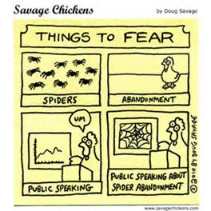
Approach-Avoidance Contingencies
Competing approach-avoidance contingencies
Operant strategies
(Dymond & Roche, 2009; Forsyth et al., 2006; Hayes, 1976; Kashdan, 2007; Pittig et al., 2014)

Slide 4
Values & Exposure
Values: augmentals that establish or enhance reinforcing qualities of an event
Target & manipulate approach contingencies
(Plumb et al., 2009; Zettle & Hayes, 1982)

Slide 5
Previous Values Studies
ACT values interventions w/ pain tolerance (e.g., Paez-Blarrina et al, 2008)
Big question: How can we have people actually live an important value by approaching fear in the lab?
Answer: Create values manipulation whereby participants were reinforced for approaching fear in a manner that allowed them to live an important value

Slide 6
Aims
Determine whether reinforcing approach in a values-consistent manner would increase approach toward a feared stimulus, relative to no reinforcement
Evaluate if the values intervention would increase willingness to engage in exposure-like task, relative to no reinforcement
Evaluate whether values intervention would influence behavior via purported mechanism of action – i.e., “decoupling”

Slide 7
Current Study & Hypotheses
Current study
Spider fearful participants who endorsed value of helping others in need completed BAT
Half received values intervention, half did not
Hypotheses
Values participants will show greater approach on the BAT + greater willingness to return and repeat
Support for mechanism of action

Slide 8
Method
Participants
Undergrads: N = 41 (39 female; M_{age} = 20.15 years, SD = 2.61)
43.9% White, 19.5% Hispanic, 12.2% African-American, 12.2% Asian, 2.4% multi-ethnic, and 9.8% other
Screening Phase
Online
FSQ, AAQ, DASS-21, modified VLQ, demographics
Eligibility
Moderate to high spider fear
Rate value of helping others in need as very important
Lab Phase

Slide 9
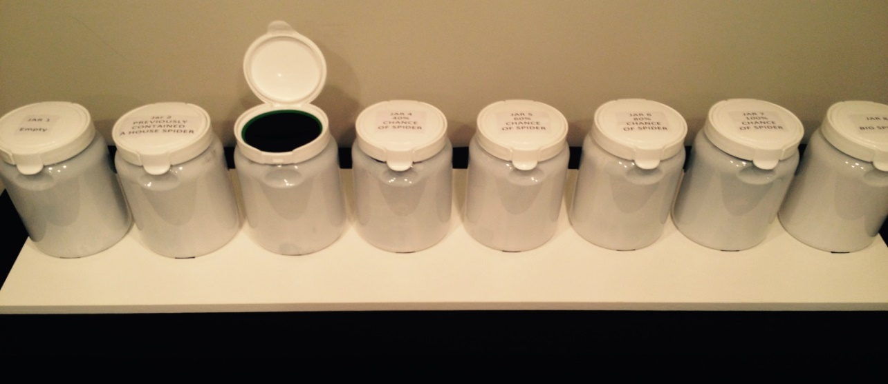
Method – Lab Phase
Perceived Threat Behavioral Approach Test (PT-BAT; Cochrane et al., 2008)
Jar 1: Empty
Jar 2: Previously contained a spider
Jar 3: 20%
Jar 4: 40%
Jar 5: 60%
Jar 6: 80%
Jar 7: 100%
Jar 8: Tarantula

Slide 10
Method – Lab Phase
Self-report assessments
SUDS ratings
0 = absolutely calm to 100 = extremely distressed
Before each PT-BAT step
PT-BAT believability
0 = not at all believable to 7 = very believable
Willingness to return and repeat the task
Yes or No
Why did you continue as far as you did on the task?
I felt like I had to
Continuing was personally important to me

Slide 11
Method – Lab Phase
PT-BAT + Self-reports
Conditions
Control (n = 20)
Completed PT-BAT
Values (n = 21)
Reinforced for each completed BAT step via meal donated to hungry person

Slide 12
Results
Means (and Standard Deviations) of Key Study Variables
Variable | Control (n = 20) |  | Values (n = 21) |  | p
Fear of Spiders Questionnaire | 58.95 (28.80) |  | 57.35 (24.51) |  | .849
Acceptance and Action Questionnaire-II | 27.86 (11.86) |  | 22.35 (11.45) |  | .139
Depression, Anxiety, Stress Scales - 21 | 22.00 (15.70) |  | 12.74 (10.47) |  | .097
Baseline SUDS | 71.81 (26.76) |  | 80.50 (12.74) |  | .196
SUDS Average | 66.69 (24.80) |  | 74.12 (18.35) |  | .284
SUDS Pre-Post Change | 0.10 (20.55) |  | 3.80 (19.28) |  | .555
Task Believability | 5.55 (1.57) |  | 5.20 (1.40) |  | .462

Slide 13
BAT Results

Slide 14
BAT Results – Impact of Intervention
Ordinal regression analysis with number of jars completed as the outcome variable
Variable | β | Wald | df | p
Condition | -1.467 | 4.87 | 1 | .027
FSQ | -0.074 | 8.80 | 1 | .003
Condition x FSQ | .026 | 0.84 | 1 | .359
Note. FSQ = Fear of Spiders Questionnaire

Slide 15
BAT Results – Spider Fear Contribution
Ordinal regression analysis with number of jars completed as the outcome variable
Variable | β | Wald | df | p
Condition | -1.467 | 4.87 | 1 | .027
FSQ | -0.074 | 8.80 | 1 | .003
Condition x FSQ | .026 | 0.84 | 1 | .359
Note. FSQ = Fear of Spiders Questionnaire

Slide 16
BAT Results – Mechanism of Action
Ordinal regression analysis with number of jars completed as the outcome variable
Variable | β | Wald | df | p
Condition | -1.467 | 4.87 | 1 | .027
FSQ | -0.074 | 8.80 | 1 | .003
Condition x FSQ | .026 | 0.84 | 1 | .359
Note. FSQ = Fear of Spiders Questionnaire

Slide 17
Results – Willingness to Return
X² = 4.20, p = .041

Slide 18
Results – Task Continuation
Why did you continue as far as you did?
Values
I felt like I had to: 35%
I felt like continuing was personally important: 65%
Control
I felt like I had to: 53%
I felt like continuing was personally important: 47%

Slide 19
Conclusions & Implications
Exposure therapy might benefit by including values work
No need to first reduce fear or distress
Values-based interventions might help increase willingness to begin and engage in exposure, and could be a useful addition to exposure protocols
Mechanism of action?

Slide 20
Extensions to Clinical Practice & What’s Next
Clinical practice
Link exposure with specific values
Highlight values during exposure
Contextualize exposures as acts of valued living
What would happen with a more extensive values intervention?
Full values-based exposure protocol?
Study provides a model for evaluating behavior within a context of competing approach and avoidance contingencies that more closely represents real-world experiences with anxiety difficulties

Slide 21
Limitations & Take-Home Message
Limitations
Power
Generalizability
Did values participants go farther because it was consistent w/ values? Or as a way to avoid the distress of not helping people in need?
Final thoughts
Questions?

Slide 22
Acknowledgements
Research assistants
Brianna Appel & Josh Ebert

